Slide 1




RISC V ARCHITECTURE

Slide 2


INTRODUCTION
In this internship, we designed and implemented a RISC-V processor, starting with a single-cycle model to establish the fundamental datapath and control. We then extended the design into a pipelined architecture to achieve instruction-level parallelism and higher throughput. This transition required addressing challenges such as data and branch hazards, which we resolved using techniques like forwarding, stalling, and branch resolution. The project provided a complete view of how pipelining enhances performance while ensuring correctness.
01

Slide 3

PROJECT GOALS
1.
Design and implement a single-cycle RISC-V processor to establish core datapath and control.
2.
Extend the design into a pipelined RISC-V processor to enable instruction-level parallelism.
3.
Identify and manage hazards (data hazards and branch hazards) introduced by pipelining.
4.
Design a UART Controller and implement on an FPGA.
02

Slide 4
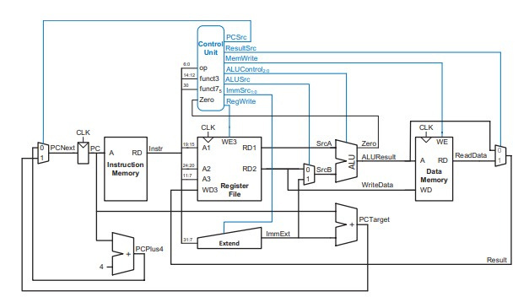

SINGLE CYCLE ARCHITECTURE
04

Slide 5

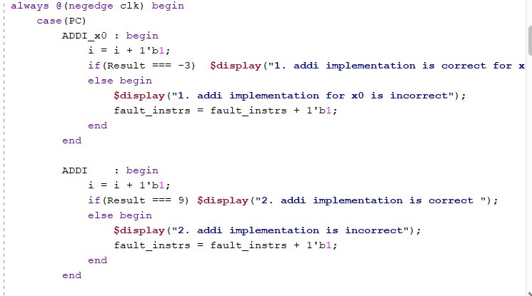
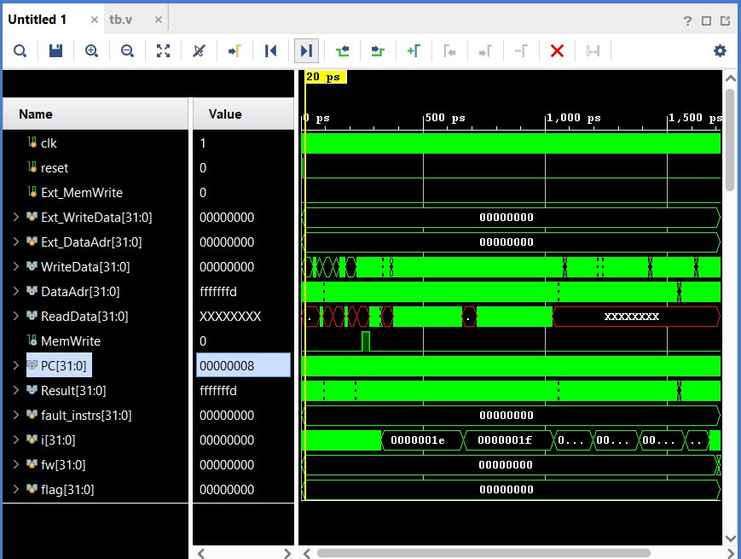
SINGLE CYCLE TESTBENCH
04

Slide 6
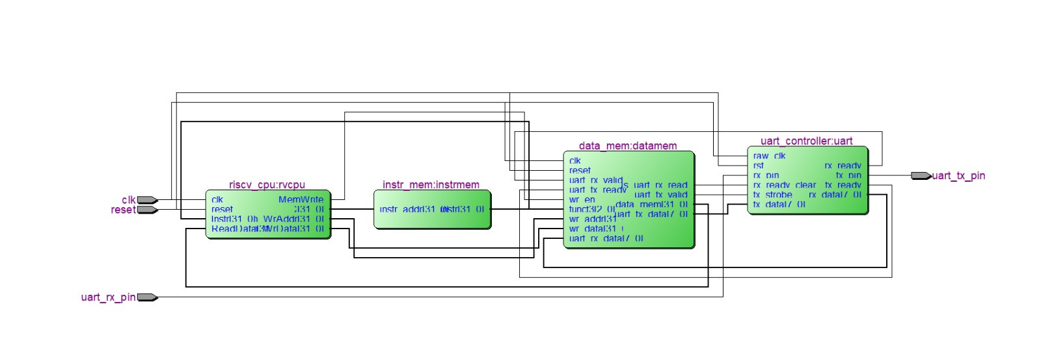
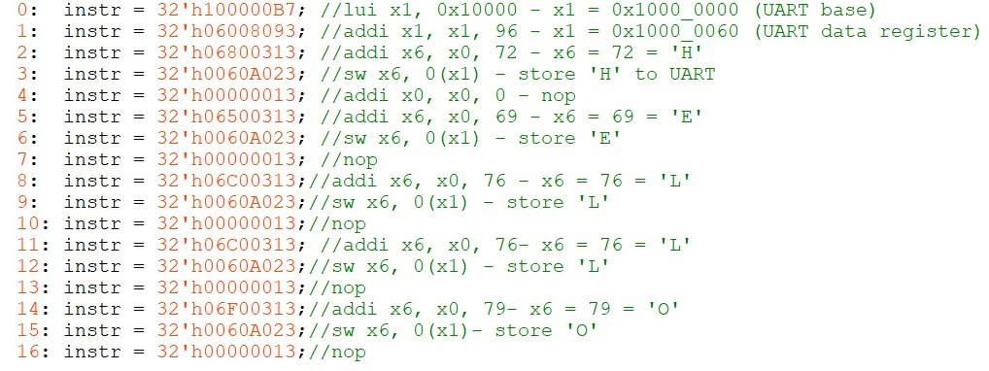

UART MODULE
03

Slide 7

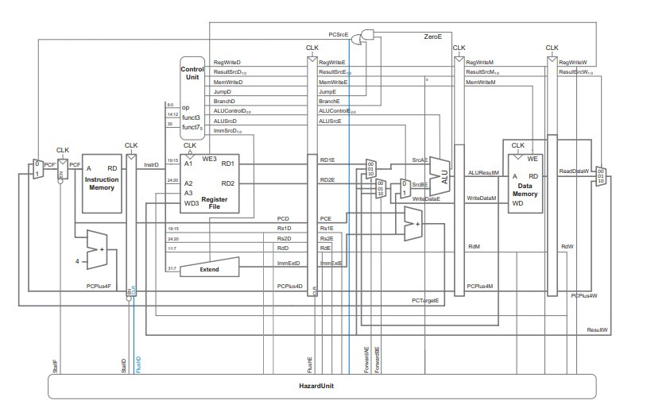
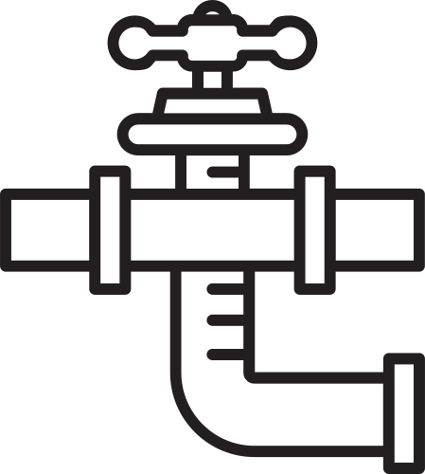
PIPELINED ARCHITECTURE
05

Slide 8

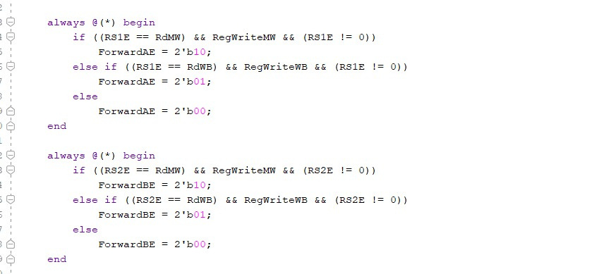
DATA HAZARD MITIGATION
06

Slide 9

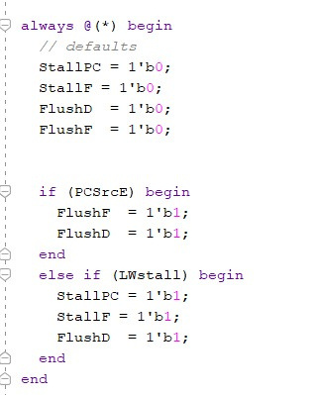
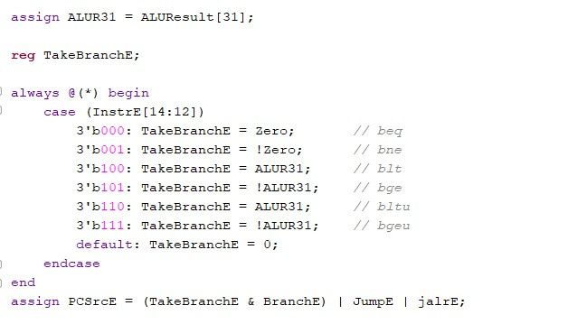
CONTROL HAZARD MITIGATION
07

Slide 10

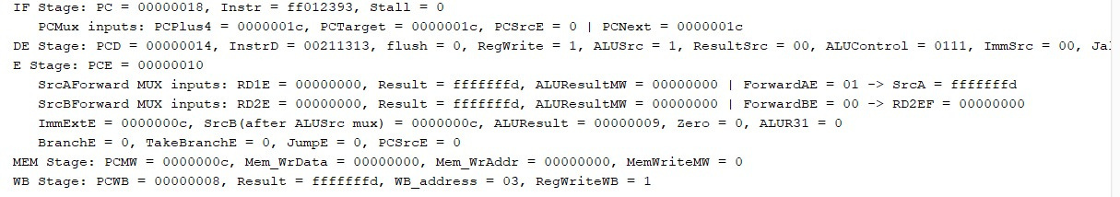
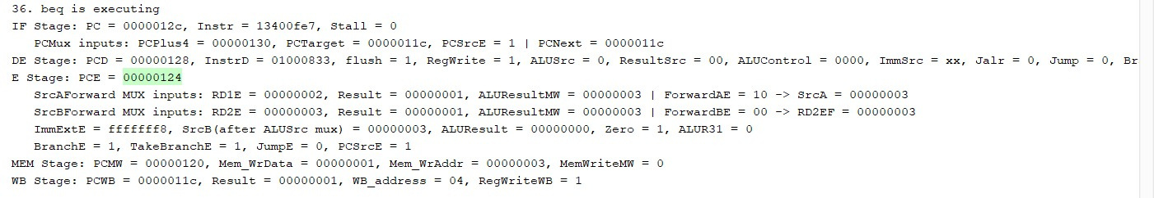
PIPELINE SIMULATION
Data Hazard Simulation
Control Hazard Simulation
08

Slide 11
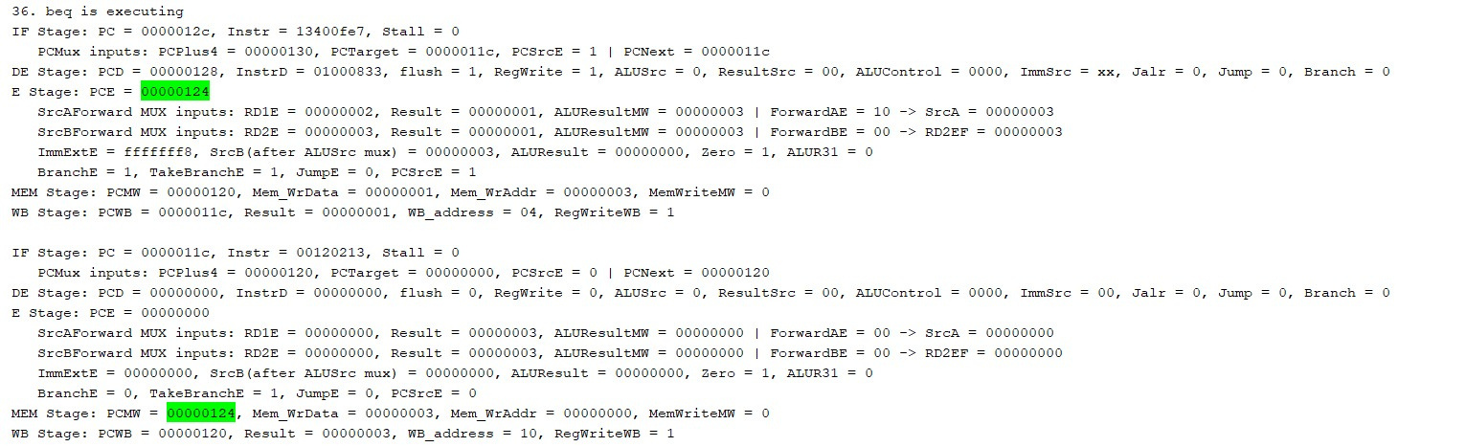
PIPELINE SIMULATION
Control Hazard Simulation
08

Slide 12

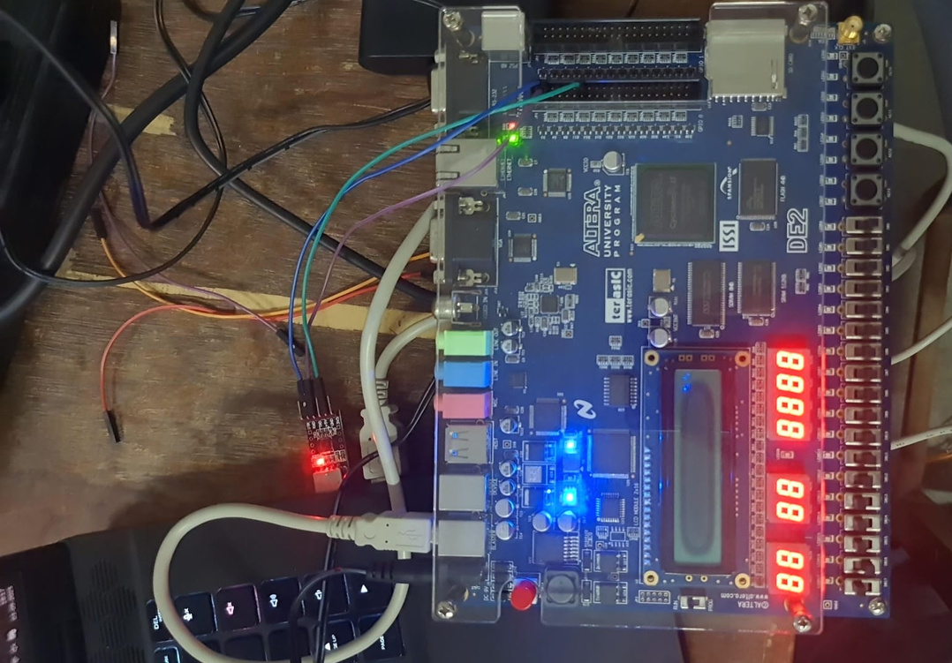
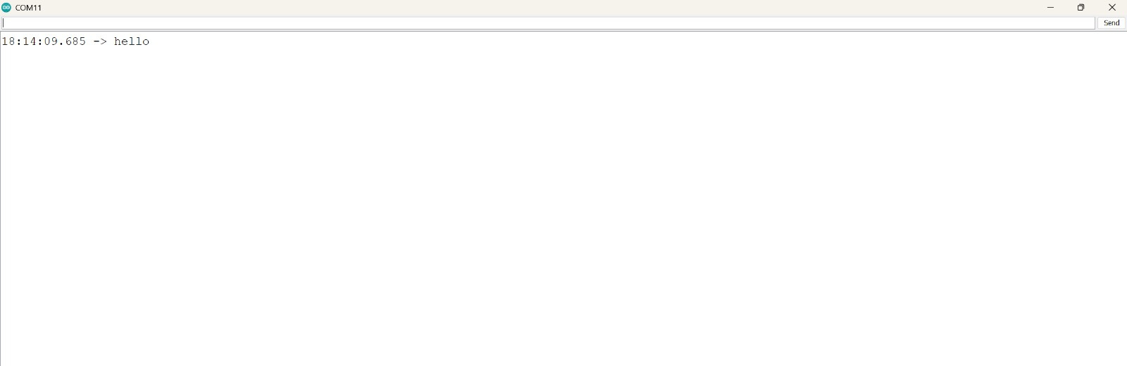
FPGA OUTPUT
09

Slide 13

CONCLUSION
  Successfully implemented the RV32I Processor starting with a Single-Cycle design and extending to a Pipelined architecture.
  Pipelining improved instruction throughput and demonstrated key computer architecture concepts such as instruction overlap and hazard handling.
  Explored UART integration for external communication, enabling data transfer between the processor and external devices.
  This project provided hands-on exposure to processor design, hardware description in Verilog, and system-level integration.
09

Slide 14
THANK YOU
10

